Slide 1
RODENT OPERANT BUCKET

Slide 2
Motivation For Work
To provide customized low cost research equipment
Increasing participation in higher education and research by making it more accessible and affordable

Slide 3
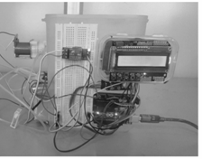
Specifications
The following objectives are derived after carefully studying the literature required for the RO Bucket:
Detect the movement of the rodent in the nose pokes of the device.
Dispense a suitable reward at the reward nose poke of 60µL drop size.
Behaviour Data is to be stored and displayed in proper graphical format.
The cost of the device should be reduced as compared to other competitors.
The design is robust and non-corrosive.

Slide 4
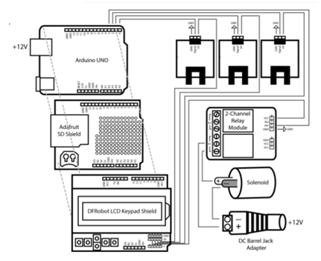
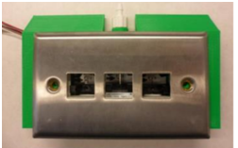
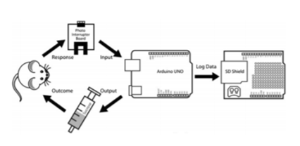
METHODOLOGY
USE OF 3D PRINTING

Slide 5
Methodology
MICROCONTROLLER
DATA LOGGER
DISPENSING
MECHANISM
SD Card Shield along with ThingSpeak OpenSource MATLAB Model
SENSOR: IR Sensors
Dispenser: Solenoid Based Drop Dispenser
ARDUINO UNO

